Slide 1

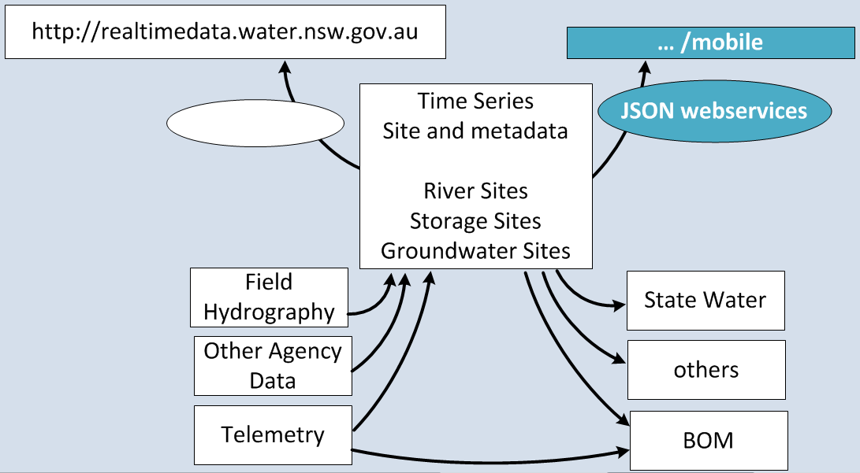
Office of Water. NSW tony.caine@water.nsw.gov.au

Slide 2

Open Water Data a road map
Surface and Groundwater data
Water quality discrete – ~300 measuring programs, ~60years, 600K samples
River biology – ~60 longitudinal experiments, ~400K taxa, ~15years, ~2M+ counts
(almost) Common Site-Id with Latitude, Longitude and Elevation
Date-time of samples, Measuring-Program
Prepared outputs
Simple web services
Standards – WDTF, WaterML 2 web services
Open Data - Open Science – Simple Access
http://creativecommons.org/licenses/by/3.0/au/

Slide 3
Call to Action +useful links
Practice:
- Some of water data is widely used
- Need to work on implementations and that scale.
- Want more data to be used. (would like to know where/how)
Open to people working with us – directly or indirectly.
Open to proposals …
Office of Water will host an AppEvent with facilitators and tools.
- Invite (External and Internal) / (Ideas and Technical)
http://realtimedata.water.nsw.gov.au/ (~500K visits PA)
http://realtimedata.water.nsw.gov.au/mobile
https://github.com/tonycaine/pages-for-appchallenge

